Slide 1

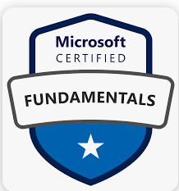
Azure Fundamentals (AZ-900)

Slide 2

Day - 3 Azure Compute Services

Slide 3
Outlines
Introduction to Compute services
Azure Virtual Machine
Azure container instance (ACI)
Azure App services
Azure Functions
Labs with examples

Slide 4
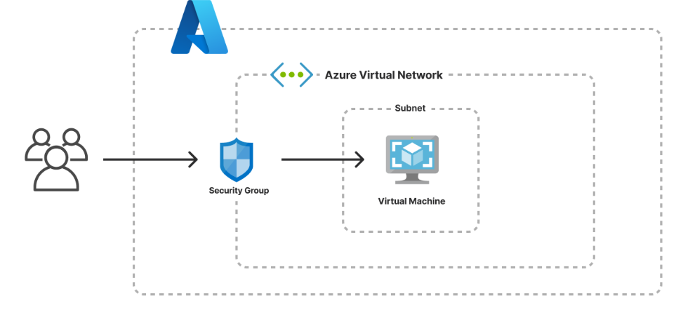
Virtual Machine
Azure Virtual Machines are image service instances that provide on-demand and scalable computing resources with usage-based pricing.
Each Virtual machine provides its own virtual hardware including CPUs, memory, hard drives, network interfaces and other devices.
Each Virtual Machine offers the flexibility of virtualization without buying and maintaining the physical hardware that runs it.
Notes:
An Azure VM gives you the flexibility of virtualization without having to buy and maintain the physical hardware that runs the VM. However, as an IaaS offering, you still need to configure, update, and maintain the software that runs on the VM.
An image is a template used to create a VM and may already include an OS and other software, like development tools or web hosting environments.

Slide 5
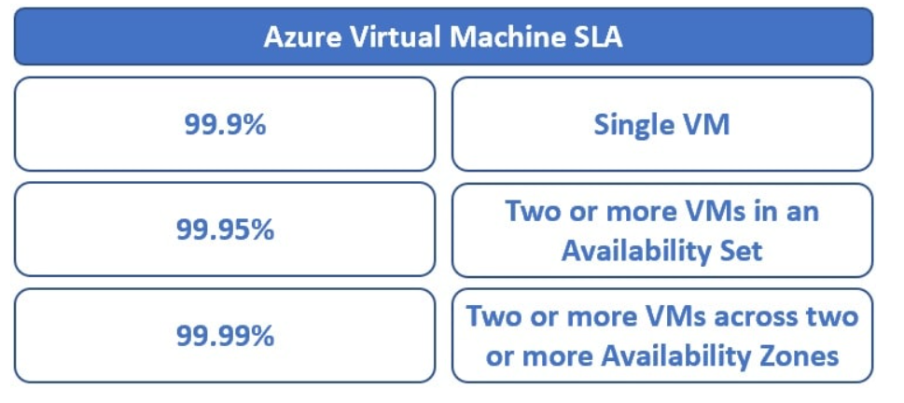
VM SLA

Slide 6
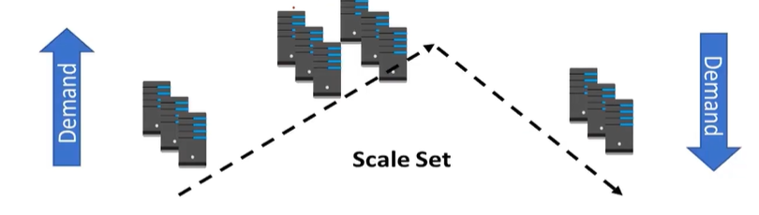
Virtual Machine Scale sets
Scale sets deploy a set of identical VMs
No pre-provisioning of VMs is required
As demand goes up VMs are add
AS demand goes down VMs are removed
The process can be manual, automated, or a combination of both.
Notes:
How do you simplify creation and management of multiple VMs?
Ex: Enter VM scale sets
Provides high availability to your applications
Distribute VM instances across Multiple AZs
Supports Manual Scaling and Auto Scaling
Supports upto 1,000 VM instances
You can run single VMs for testing, development, or minor tasks. Or you can group VMs together to provide high availability, scalability, and redundancy. Azure can also manage the grouping of VMs for you with features such as scale sets and availability sets.
The number of VM instances can automatically increase or decrease in response to demand, or you can set it to scale based on a defined schedule. Virtual machine scale sets also automatically deploy a load balancer to make sure that your resources are being used efficiently. With virtual machine scale sets, you can build large-scale services for areas such as compute, big data, and container workloads.

Slide 7
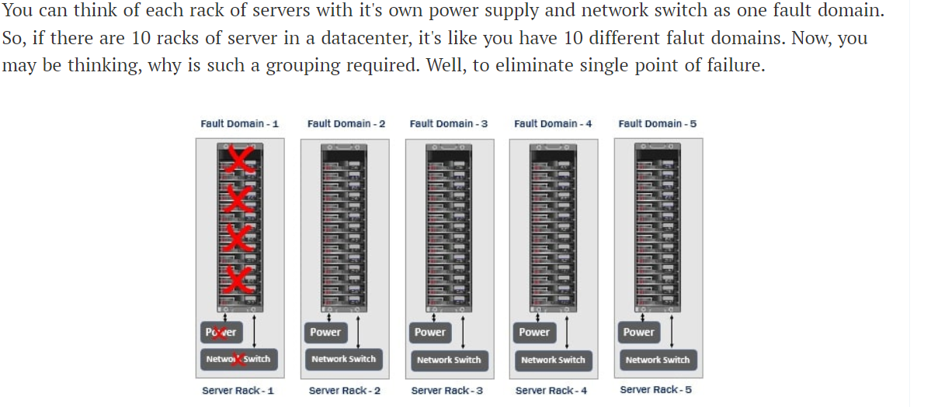
Virtual Machine Availability Set
The servers in a datacenter are divided into multiple physical and logical groups.
physical grouping : fault domain
logical grouping : update domain

Slide 8
Update domain
An update domain is a group of resources that can be updated and rebooted if required at the same time.
From time to time, patches and software updates need to be applied. Some updates require servers to be rebooted.
Only one update domain is rebooted at a time.
A rebooted update domain is then given 30 minutes to recover before maintenance is initiated on a different update domain.
This reduces the downtime to a great extent.
What may happen if availability sets are not used

Slide 9
What may happen if availability sets are not used
In real-world, web applications that have lot of demand, for example Google.com, Gmail.com, and Amazon.com may have many many web servers and database servers.
However, our example simple, let's just stick to two web servers and two database servers. The load balancer obviously distributes the incoming traffic between the two web servers.

Slide 10
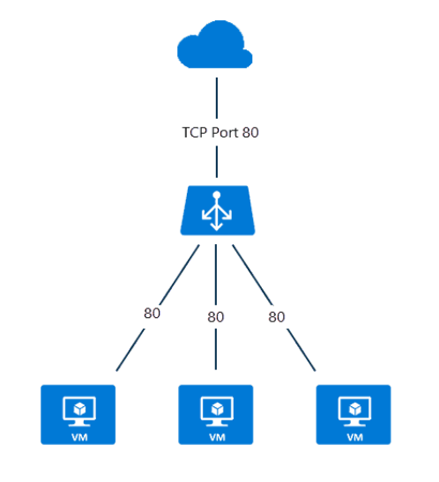
Load Balancer
Distribute traffic to your backend virtual machines.
An Azure load balancer provides high availability for your application.
Can create 2 types of the load balancer in Azure.
1. Public load balancer
A public load balancer has a public IP address that is accessible from the internet.
2. Internal / private load balancer
A private load balancer has an IP address from the hosting subnet,
which is visible only within your VCN.
Notes:
https://k21academy.com/az-305/azure-load-balancer-step-by-step/
A public load balancer can be used to load balance internet traffic to virtual machines. It can provide outbound connections for virtual machines (VMs) inside your virtual network.
An internal (or private) load balancer is used to balance traffic from within a virtual network.

Slide 11
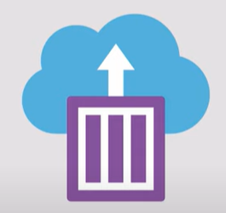
Azure Container Instance (ACI)
Azure Container Instances (ACI) is a service that enables a developer to deploy containers on the Microsoft Azure public cloud without having to provision or manage any underlying infrastructure.
The service supports both Linux containers and Windows containers.
It eliminates the need for a developer to provision virtual machines (VMs) or implement a container orchestration platform, such as Kubernetes, to deploy and run containers.
Notes:
https://www.youtube.com/watch?v=jAWLQFi4USk&ab_channel=AdamMarczak-AzureforEveryone
https://www.techtarget.com/searchcloudcomputing/definition/Azure-Container-Instances
Manage and run simple container based applications
You do not need to provision and manage VMS
Start containers in seconds
Azure app service also supports deploying simple containers
Easily deploy the applications into Azure containers

Slide 12
App Services
App Service is type of PaaS and provide application hosting option on cloud.
Both VMs and containers provide excellent hosting solutions
Azure App Service is a robust hosting option that you can use to host your apps in Azure
Azure App Service focus on building and maintaining your app, and Azure focuses on keeping the environment up and running.
It offers automatic scaling and high availability.
App Service supports Windows and Linux.
It enables automated deployments from GitHub, Azure DevOps, or any Git repo to support a continuous deployment model.

Slide 13
Types of App services
Web apps
API apps
WebJobs
Mobile apps
It supports multiple languages, including .NET, .NET Core, Java, Ruby, Node.js, PHP, or Python.
Pros:
Sites can be scaled quickly to handle high traffic loads.
The built-in load balancing and traffic manager provide high availability.

Slide 14
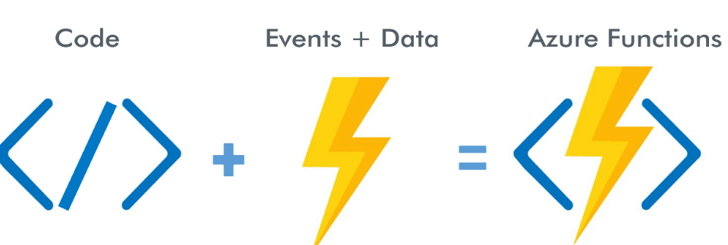
Azure Functions
It is a serverless computing service provided by MS Azure.
Functions allows you to run small pieces of code (called "functions") without worrying about platform or infrastructure.
Build and deploy small, event-driven applications or functions in the cloud that can be triggered by various events or schedules.
These functions are written in C#, JavaScript, Python or PowerShell.
Notes:
https://www.youtube.com/watch?v=eS5GJkI69Qg&ab_channel=WafaStudies
What do we think about whne we develop an application ?
Where to deploy ? what kind of server ? What OS?
How do we take care of scaling and availability of the application?
What if you don't need to worry about servers and focus on your code?
Enter serverless
Remember : serverless does not mean "No servers"
You don't worry about infrastructure
Flexible scaling and automated high availability
Most important : Pay for use
Ideally Zero request ==> Zero cose
You focus on code and the cloud managed service takes care of all that is
needed to scale your code to server millions of request
Pay for requests and not servers

Slide 15
Function Use case
Azure Functions runs your code when it's triggered and automatically deallocates resources when the function is finished.
only charged for the CPU time used while your function runs.
Building a notification system for an e-commerce website.
Example: you have an online store send notification to the customer whenever a new product is added to a specific category, they are interested in.
Azure functions to achieve the above one using the below ones
1) Trigger 2) Function Logic 3) Notification Generation 4) Notification Delivery

Slide 16
Quiz Time

Slide 17
Q
A

